Slide 1



CyberSecurity Education Platform
Ionescu Rares-Andrei
Group:1211EB
Faculty: Faculty of Engineering in Foreign Languages
Coord Teacher:
Sl. Dr. ing. Mitrea Dan Alexandru

Slide 2
Contents
Programming Languages Used
Comparison
Differences, new or improved to other applications
Objectives
Presentations of the website
Conclusion

Slide 3

Programming Languages
In this project I have used a multitude of programming languages to able to design and create the page
HTML
CSS
JavaScript
Different Frameworks:
Node.js
Express
MongoDB
Mongoose
Passport
Ejs

Slide 4
Comparison
CBTNuggets
HackTheBox
TheHackerNews
CybersecurityNews
I wanted to create a mixture of a learning platform and a news webpage. For comparison I found the websites CBTNuggets and HackTheBox as the learning platforms. And CybersecurityNews and TheHackerNews as the news webpages.

Slide 5
Comparison – CBTNuggets & HackTheBox
Like on CBTNuggets I have presented a couple of courses made by myself. Mine are introductory level courses, while theirs are from beginner to expert level courses. A difference between the websites is that I presented also courses from other great websites.
Talking now about HackTheBox platform, a feature alike is the fact that both websites present challenges/modules(HackTheBox) for the user to see his level in cybersecurity knowledge. Recently, HackTheBox have also posted a couple of self made certificates. A difference would be a bigger variety of modules/courses these websites offer, but on my website, besides the learning part I also have a news page from where the user may get the newest and most searched for information.

Slide 6
Comparison – CyberSecuritynews & TheHackernews
Another comparison would be the CyberSecurityNews and TheHackerNews website which don’t have the learning paths, but they offer a great variety of news.

Slide 7

Differences, new or improved
Compared to the learning platforms presented above, mine has got also a news page. From the point of view of the learning part of the website, mine offers some personal made courses, while CBTNuggets offers only courses from big companies. Basically my website combines the personal made courses/challenges like HackTheBox and the professional courses like on the CBTNuggets.

Slide 8

Objectives
To make this web app a mixture of a learning platform, with many courses and challenges/quizzes and a news platform, so that the user won’t need to navigate through a multitude of platforms to find the information he wants.

Slide 9

Features, Advantages, Disadvantages
A home page, from which the user could login/register or navigate to the news/about pages. The website won’t let an unregistered user access the courses nor the challenges.
Built in Login/Register/Logout with the help of passport, passport-local and passport-local-mongoose. The Username and the Email of the users are stored in plain text in the database, while the passwords are hashed with the help with Passport, which already applies the salt and the hashing algorithm to the passwords so that they are stored safely inside the database.
Managed to catch any errors. Used a boilerplate.ejs file to define easier the layout of the pages and also helps with the validation of the forms.
Stored cookies for each session on the web app
Connected the MongoDB with the help of Mongoose and the server from Express

Slide 10

Features, Advantages, Disadvantages
Advantages:
Dynamic website, friendly with any kind of desktop size.
A combination of a learning platform and news platform for the accessibility of the user.
Disadvantages:
Not enough variety in the courses and challenges, yet.
Vulnarable to XSS(Cross-site scripting)

Slide 11
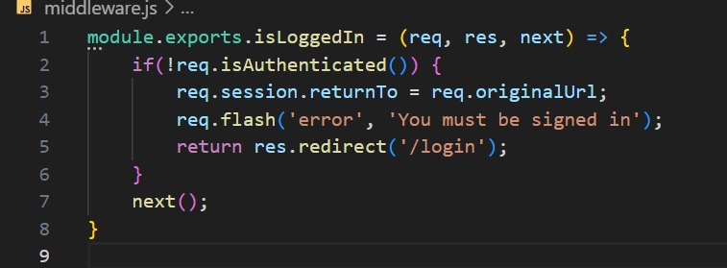
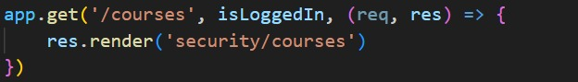
Features, Advantages, Disadvantages
Here I created a function isLoggedIn to check if the user is logged in the website to be able to access the pages. Only News and About pages are available for unsigned users.

Slide 12
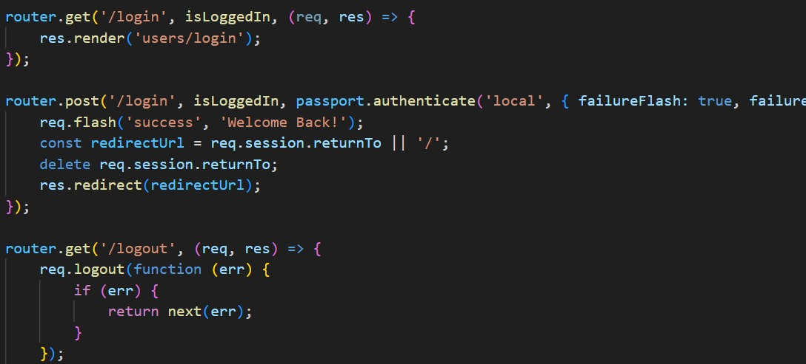
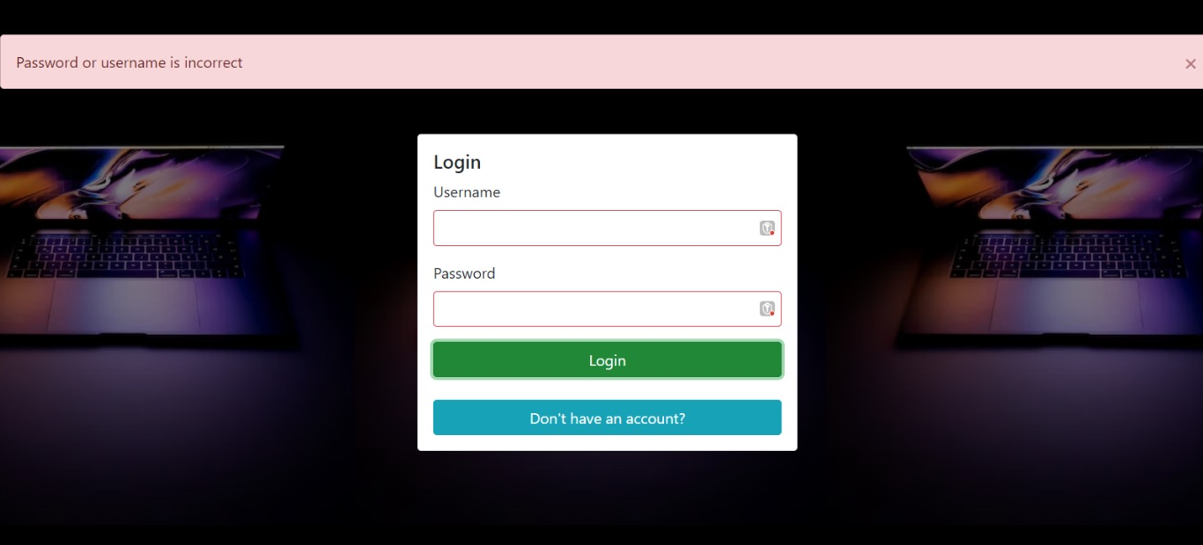
Features, Advantages, Disadvantages
Here is the code for the verification for the login page. Checks if the username and the password from the database match.

Slide 13
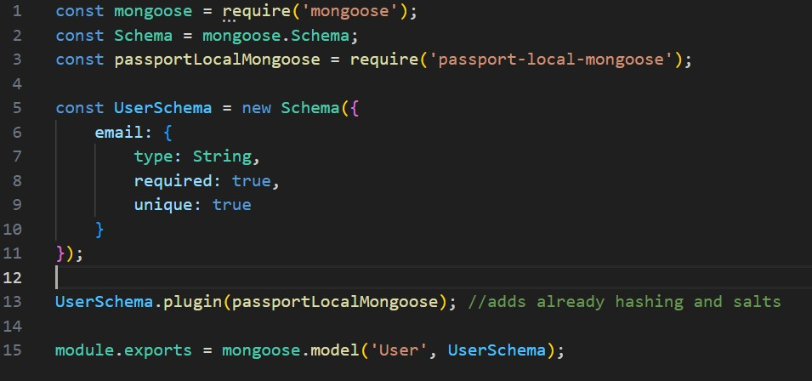
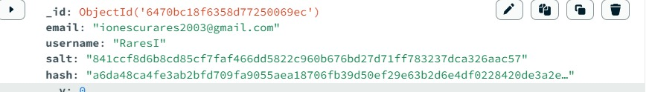
Features, Advantages, Disadvantages
This is the schema for the user. We require only the email manually here, because with the help of the plugin passportLocalMongoose we get the username and the hashed password into the database.

Slide 14
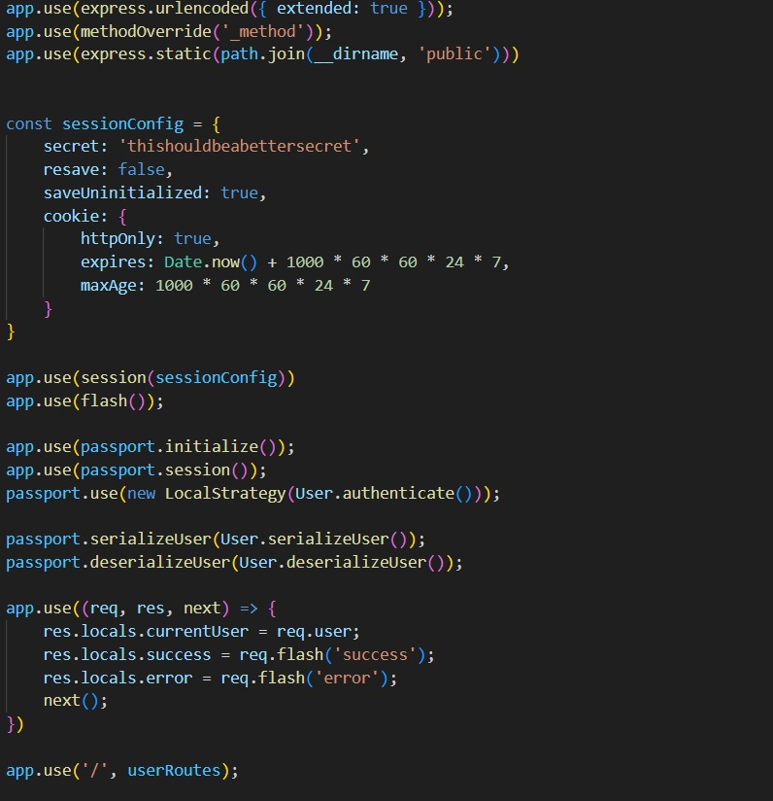
Features, Advantages, Disadvantages
Here I created to code to configure a cookie for the session, it expires in one week. Below I have initialized the passport.

Slide 15
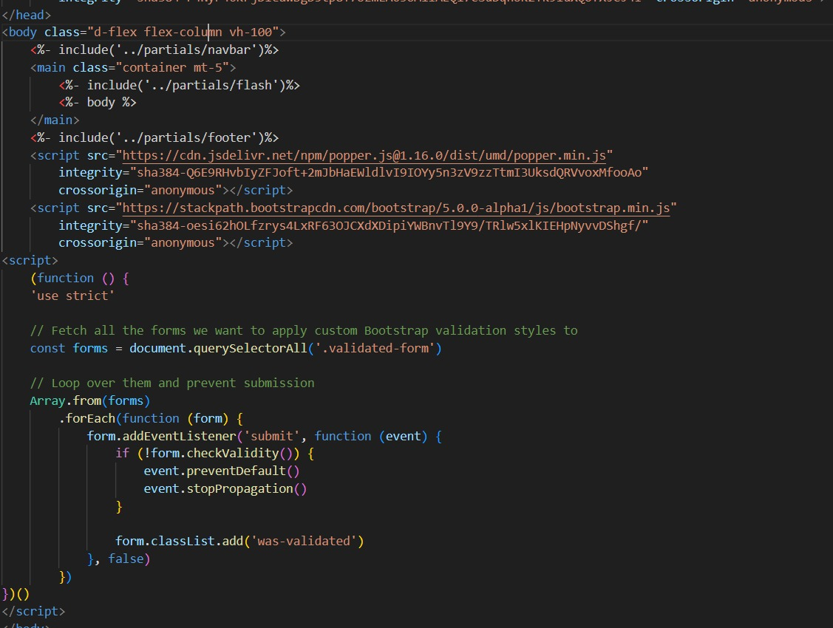
Features, Advantages, Disadvantages
Here I created the file boilerplate.ejs to help me create other pages and use it as a layout and add any other changes to the specific pages.
Also used it to verify the forms login/register

Slide 16
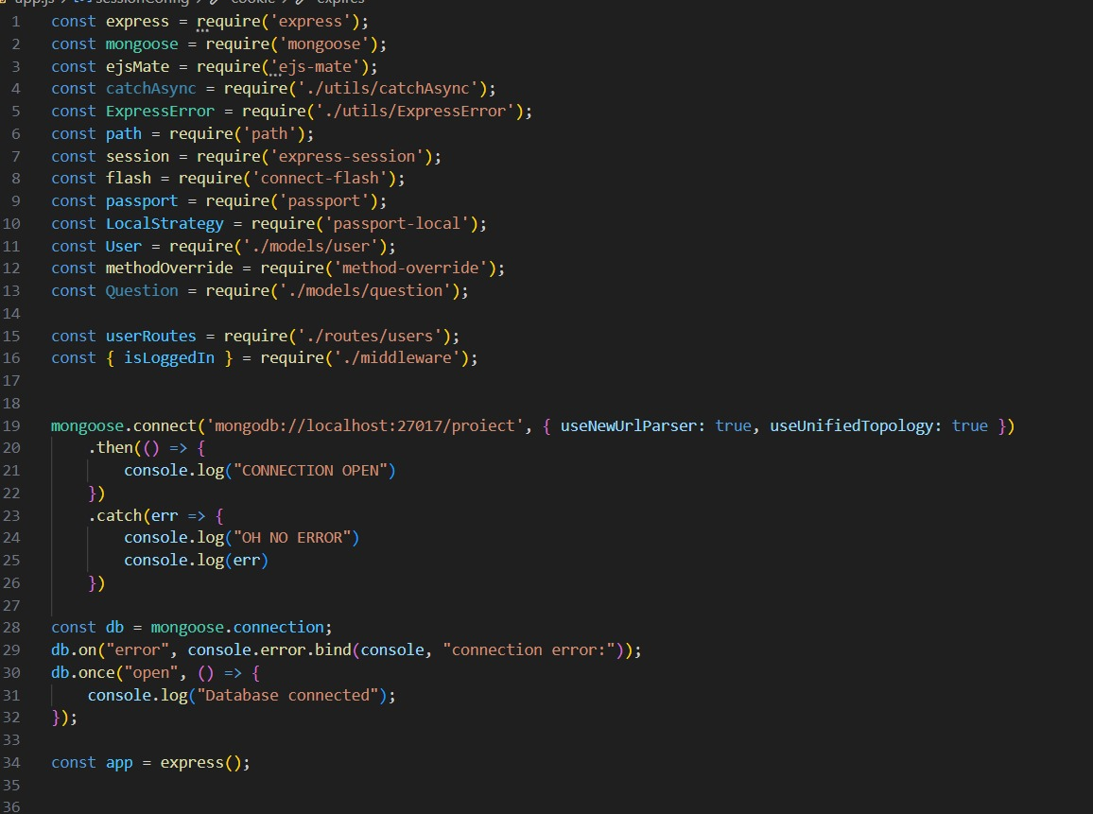
Features, Advantages, Disadvantages
This is the base of the web app, where I required everything needed to make it work.
Also created the connection within the database and the website.

Slide 17
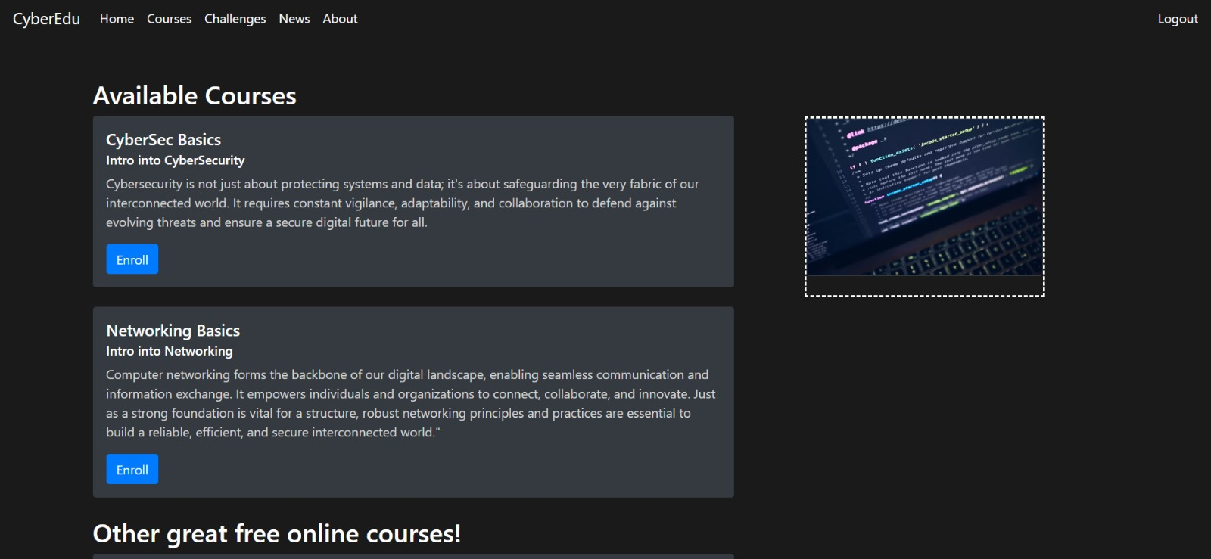
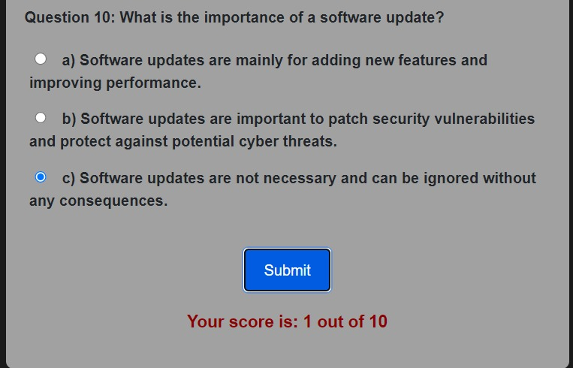
On the right is the courses page, after the user logged in.
Below is a test, with the result of the user.

Slide 18
Conclusion
I will add better security functions to prevent common attacks
A bigger variety of Courses and Challenges
A function to update automatically the new top news worldwide
More quizzes with the questions and answers stored in a database, also a function to let the user propose questions.
Add also better styling for the pages.

Slide 19

Thank you for your attention!

